Slide 1
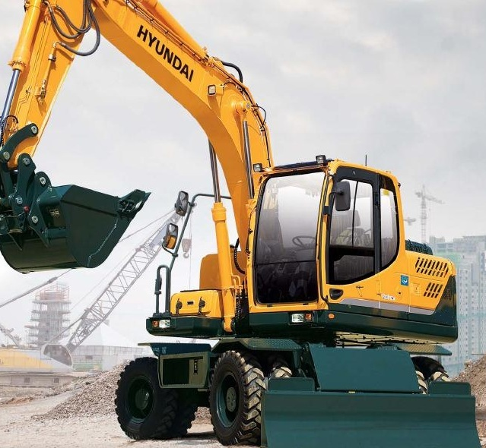
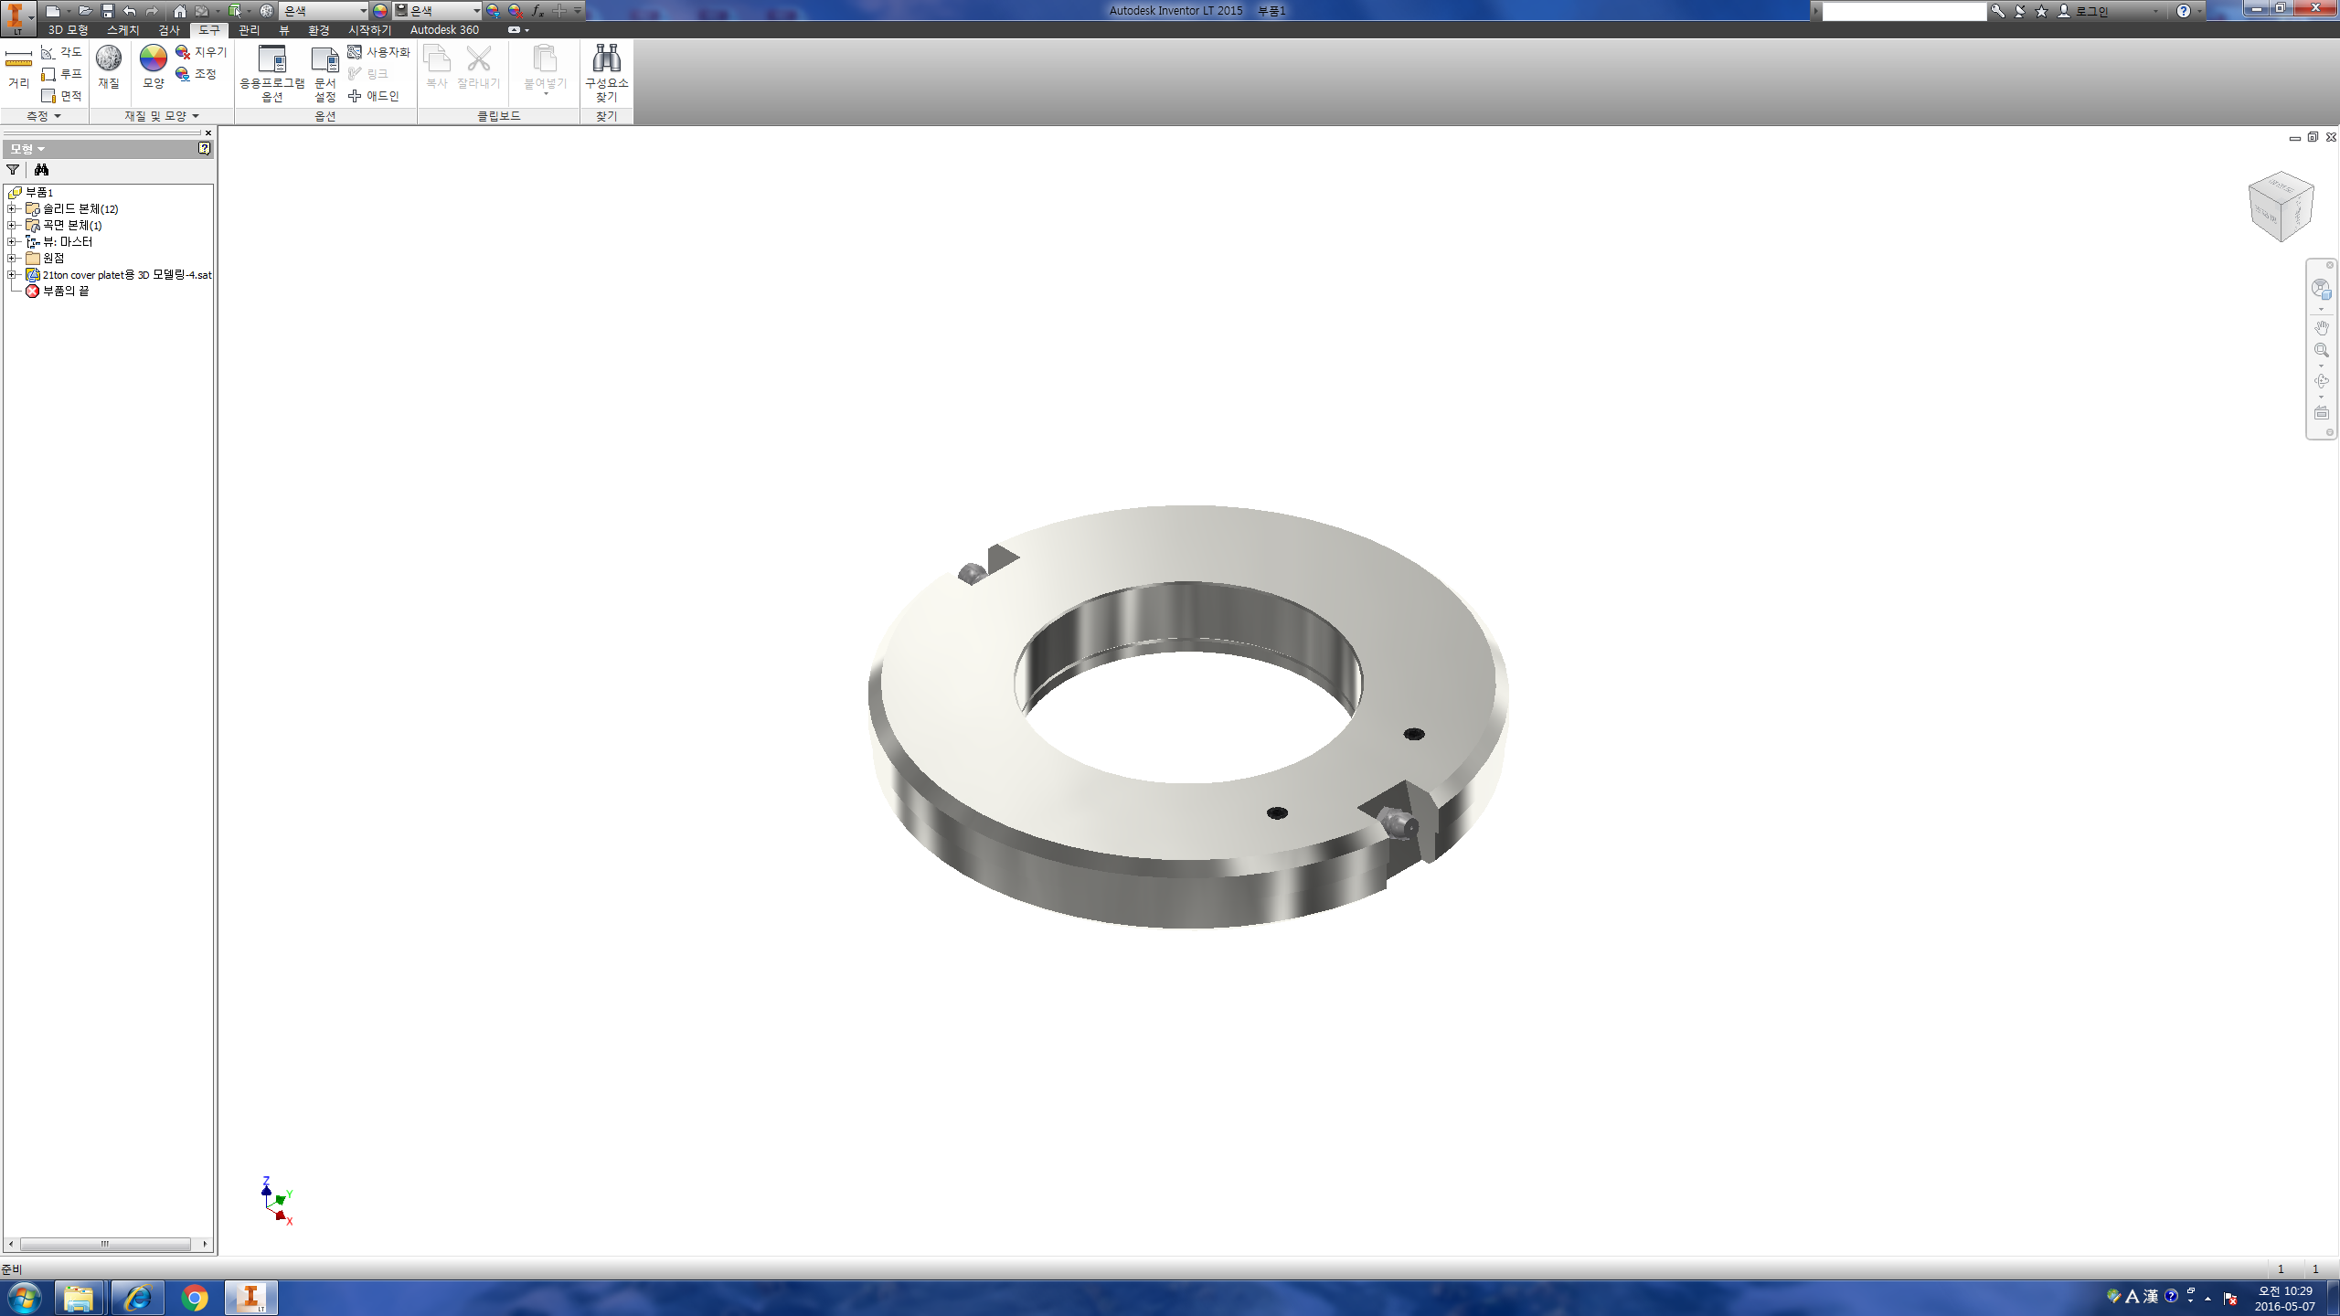
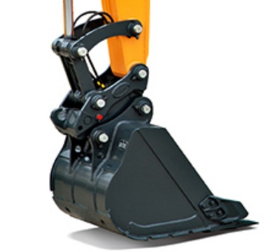
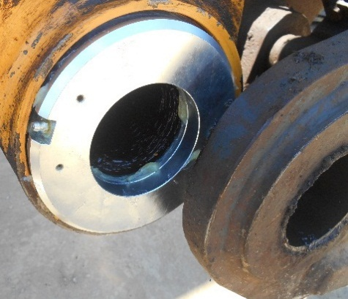

HYUNDAI GENUINE PARTS
Variable DISC
“ Automatic Gap
Adjustment Device”
Perfect Solution for
Bucket Movement!
■ Applied Vehicles
9 Series Excavator
-21ton ( Pin Size Ø80 )
-30ton ( Pin Size Ø90 )
-52ton ( Pin Size Ø120 )
Authorized dealer

Slide 2
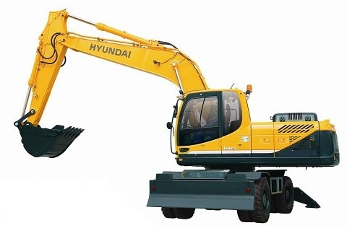
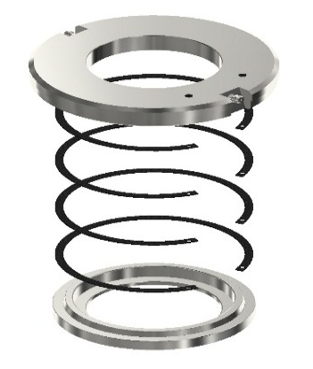
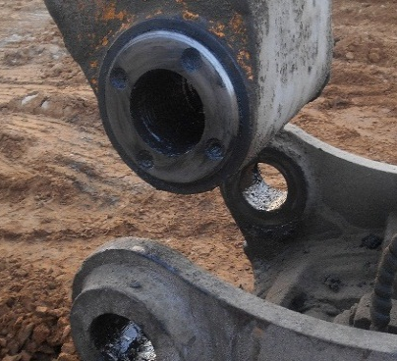
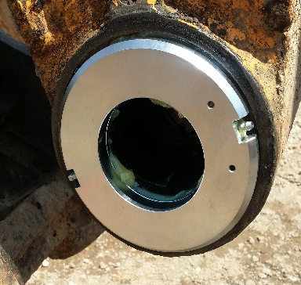
No Need to Use Washer Any More
● Applied Position
ㆍBucket or Quick Coupler
Variable DISC vs Washer
Accomplish All of Assignd Work All At Once !
Classification | Variable DISC | Standard Washer
Workability | Gap Repair in One Installation | Repetitive tasks
Manageability | Simple Modification of Bucket Movement | Low Efficiency
Composition
Gap Adjustability by Adding Grease
ㆍSlim Size Cylinder Concept
Component
ㆍReplace Washers as Multiple internal Snap Rings
Simple Installationity
Replace existing Cover Plate
①Remove Pin from Bucket
(Quick Coupler)
②Remove Cover Plate from Arm
③Install Variable DISC
(NO Bolts Needed)
④Reassemble Removed Pins for
Completion
Original Cover Plate
Variable DISC

